Slide 1






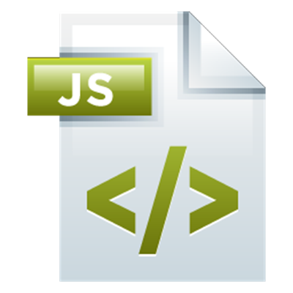
Introduction to Node.js
Basic Components
Express.js Development
SoftUni Team
Technical Trainers
Software University
http://softuni.bg

Slide 2

Table of Contents
Overview of Node.js
IDE setup
Modules
Basic Web Server

Slide 3
Have a Question?
sli.do #express-js

Slide 4
Overview of Node.js
Why Node is good?

Slide 5
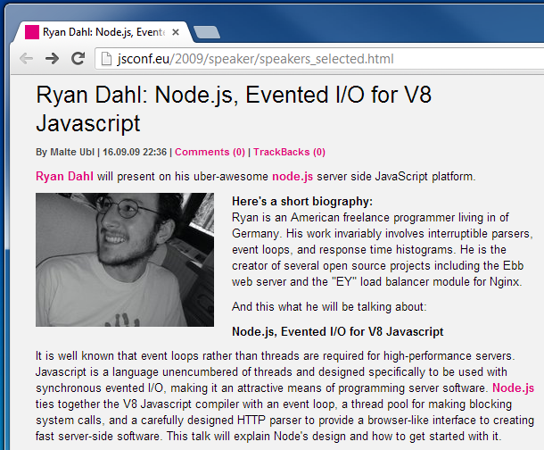
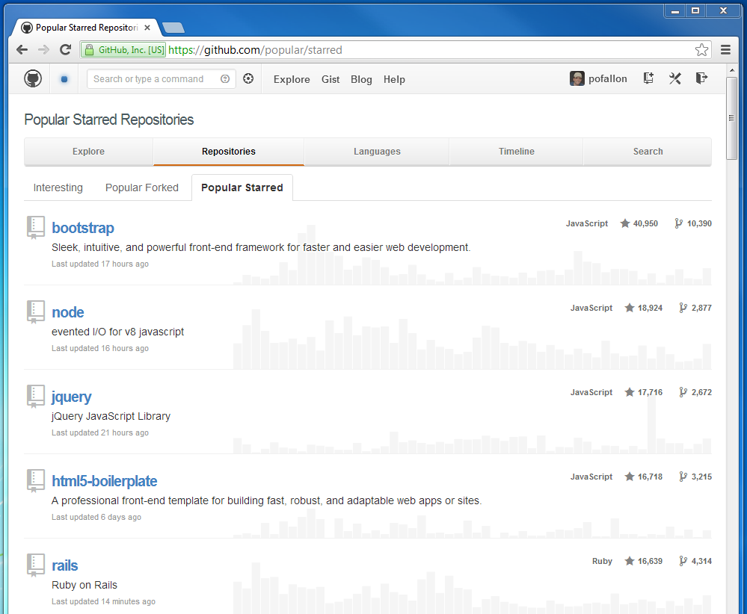
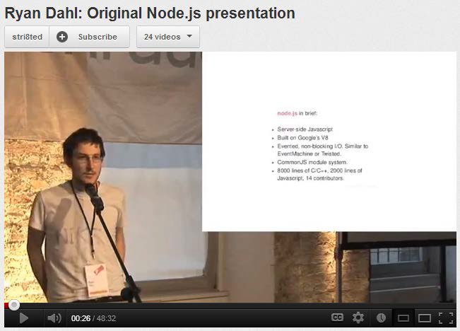
Overview of Node.js
Background

Slide 6
Why Node.js
Node.js is written in JavaScript
One language on the server and the client
Full control of the server capabilities
Asynchronous and fast
One of the fastest web servers
Popular among developers
Perfect for microservices

Slide 7
Building Blocks of Node.js
Node.js
libuv – high-performance I/O library
V8 – Google Chrome’s JavaScript engine
JavaScript -> C++
Installation
Go to http://nodejs.org
Install latest version (7.0.0 or above)
Run Command Prompt and type "node"

Slide 8
Our first Node.js script
Hello World? No? OK!

Slide 9
NPM Init
Go to a folder of your choice
Open CMD and type "npm init"
Follow the instructions
Type "npm install standard --save-exact"
Go to the created 'package.json' file and add
"engine": "7.1.0",
"scripts": {
"start": "node index.js“
},

Slide 10
Configuring Visual Studio Code
If you want to use VS Code
Download from https://code.visualstudio.com/
Follow instructions for Node.js (jsconfig and typings) https://code.visualstudio.com/docs/runtimes/nodejs
Install the Standard code checker https://marketplace.visualstudio.com/items?itemName=chenxsan.vscode-standardjs
Add 'index.js' file
Hit F5
Or use another IDE ☺

Slide 11
The Event Loop
The Core Node Component

Slide 12
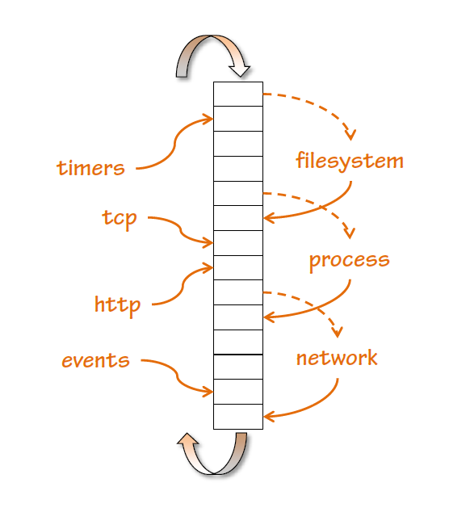
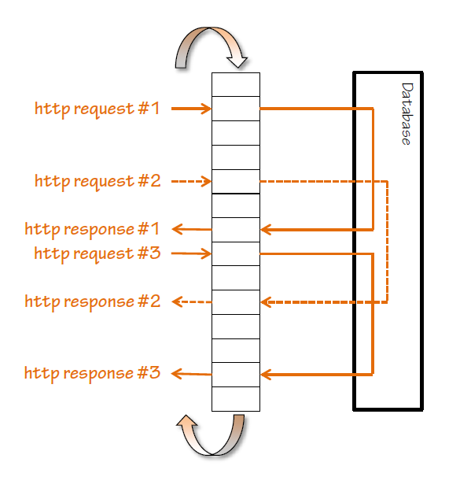
The Event Loop

Slide 13
Asynchronous Code
The synchronous way
var conn = getDbConnection(connectionString);
var stmt = conn.createStatement();
var results = stmt.executeQuery(sqlQuery);
for (var i=0; i<results.length; i++) {
// print results[i];
}

Slide 14
Asynchronous Code
The Node.js asynchronous way
getDbConnection(connectionString, function(err, conn) {
conn.createStatement(function(err, stmt) {
var results = stmt.executeQuery(sqlQuery);
results.on('row', function(result) {
// print result
});
});
});

Slide 15
Asynchronous Code
Conventions
The function callback is the last parameter in the async call
Error is the first parameter in the callback
Always check errors and handle them correctly!
var handleResults = function(error, results) {
// if error is undefined…
// do something with the results
}
getStuff(inputParam, handleResults);

Slide 16
Using Modules
Making Our App Modular

Slide 17
How To Use Modules
Modules are used with "require“
You can require built-in and custom made modules
var first = require('first');
var Second = require('second');
var justPart = require('largeModule').justPart;
var propertyResult = 2 + first.property; // export variable
var functionResult = first.function() * 3; // export function
var second = new Second(); // export object
console.log(justPart()); // export part of object

Slide 18
Built-in Modules
They come with Node.js
Can be required with a string identifier
Commonly used modules
fs, http, crypto, os
More at https://nodejs.org/api/
var fs = require('fs');

Slide 19
Your Modules
Each .js file in the project folder is a module
Can be required with a file system semantics
When required the file extension is not needed
var data = require('./data'); // in same directory
var a = require('./other/a'); // in child directory
var b = require('../lib/b'); // in parent directory's child
var justPart = require(‘./data’).part; // just part of module

Slide 20
Your Modules
You export the module by using "module.exports"
// first.js
var count = 2;
var doIt = function(i, callback) { … }
module.exports.doIt = doIt;
module.exports.someVar = 'result';
// second.js
var one = require('./first');
one.doIt(23, function (err, result) {
console.log(result);
});
console.log(one.someVar);
console.log(one.count); // invalid

Slide 21
Third-Party Modules
Installed from Node Package Manager (NPM)
Run "npm install module --save-exact"
Can be required with the module name
Some modules have command line tools
Run "npm install –g module"
For example 'express', 'mocha'
Run only "npm install", if you want to restore the packages

Slide 22
Node.js Web Server
Let's start the fun!

Slide 23
What Do the Web Servers Do? (Again)
All physical servers have hardware
The hardware is controlled by the operating system
Web servers are software products that use the operating system to handle web requests
Web servers serve Web content
These requests are redirected to other software products (ASP.NET, PHP, etc.), depending on the web server settings

Slide 24
A Simple Node.js Web Server
Let's write a simple Node.js web server
const http = require('http')
http
.createServer((req, res) => {
res.write('Hi!')
res.end()
})
.listen(1337)
console.log('Node.js server running on port 1337')

Slide 25








JavaScript Web – Express.js Fundamentals
https://softuni.bg/trainings/1434/node-js-development-september-2016

Slide 26

License
This course (slides, examples, demos, videos, homework, etc.) is licensed under the "Creative Commons Attribution-NonCommercial-ShareAlike 4.0 International" license
Attribution: this work may contain portions from
"End-to-end JavaScript Applications" course by Telerik Academy under CC-BY-NC-SA license

Slide 27





Free Trainings @ Software University
Software University Foundation – softuni.org
Software University – High-Quality Education, Profession and Job for Software Developers
softuni.bg
Software University @ Facebook
facebook.com/SoftwareUniversity
Software University @ YouTube
youtube.com/SoftwareUniversity
Software University Forums – forum.softuni.bg

